Slide 1




Voicer
“It’s time to Speak”
By Hackvengers

Slide 2


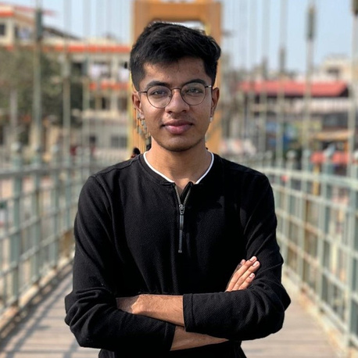
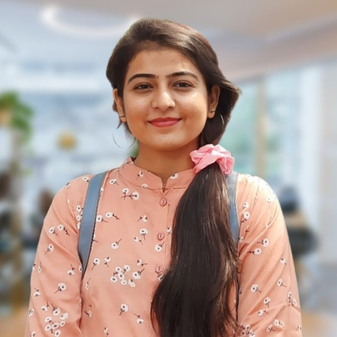
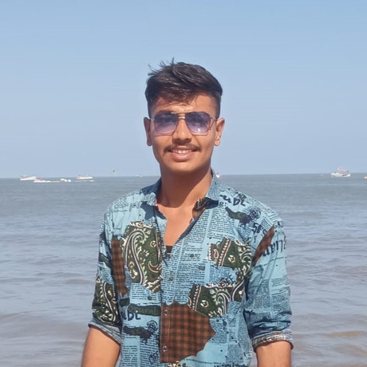


Let’s meet the TEAM
Varun Thummar
Aditi Patel
Amit Gohel
LinkedIn
LinkedIn
LinkedIn

Slide 3




Idea Purpose
" To help an inclusive society that ensures equal opportunities for the growth and development of individuals who are deaf or unable to speak. "

Slide 4


What's the Problem?
Use sign language for communication.
According to the National Geographic Society, approximately 72 million people in the world use sign language.
In India, the number is approximately 10 million.
Face difficulties in communicating with others who don’t know sign language like us.
They often have to rely on sign language interpreters.
India in spite of having a large Deaf population, we have only around 300 skilled interpreters. (1 interpreter over approx. 33K Individuals)
Hiring an interpreter might be expensive and inconvenient for all.
source: https://education.nationalgeographic.org/resource/sign-language/
https://nhm.gov.in/index1.php?lang=1&level=2&sublinkid=1051&lid=606

Slide 5
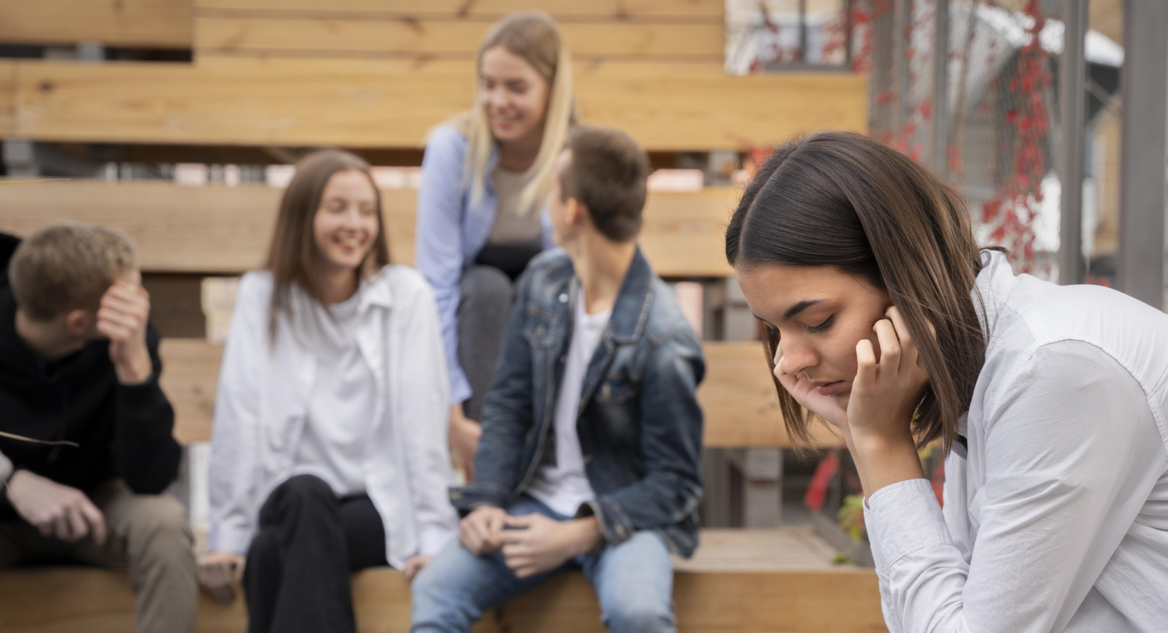

What's the Problem?
Sign language users may face several challenges in their day-to-day interactions with normal people who do not know sign language. such as;
Communication Barriers
Limited Accessibility
Misunderstandings and Miscommunication
Limited Employment Opportunities
Social Isolation

Slide 6


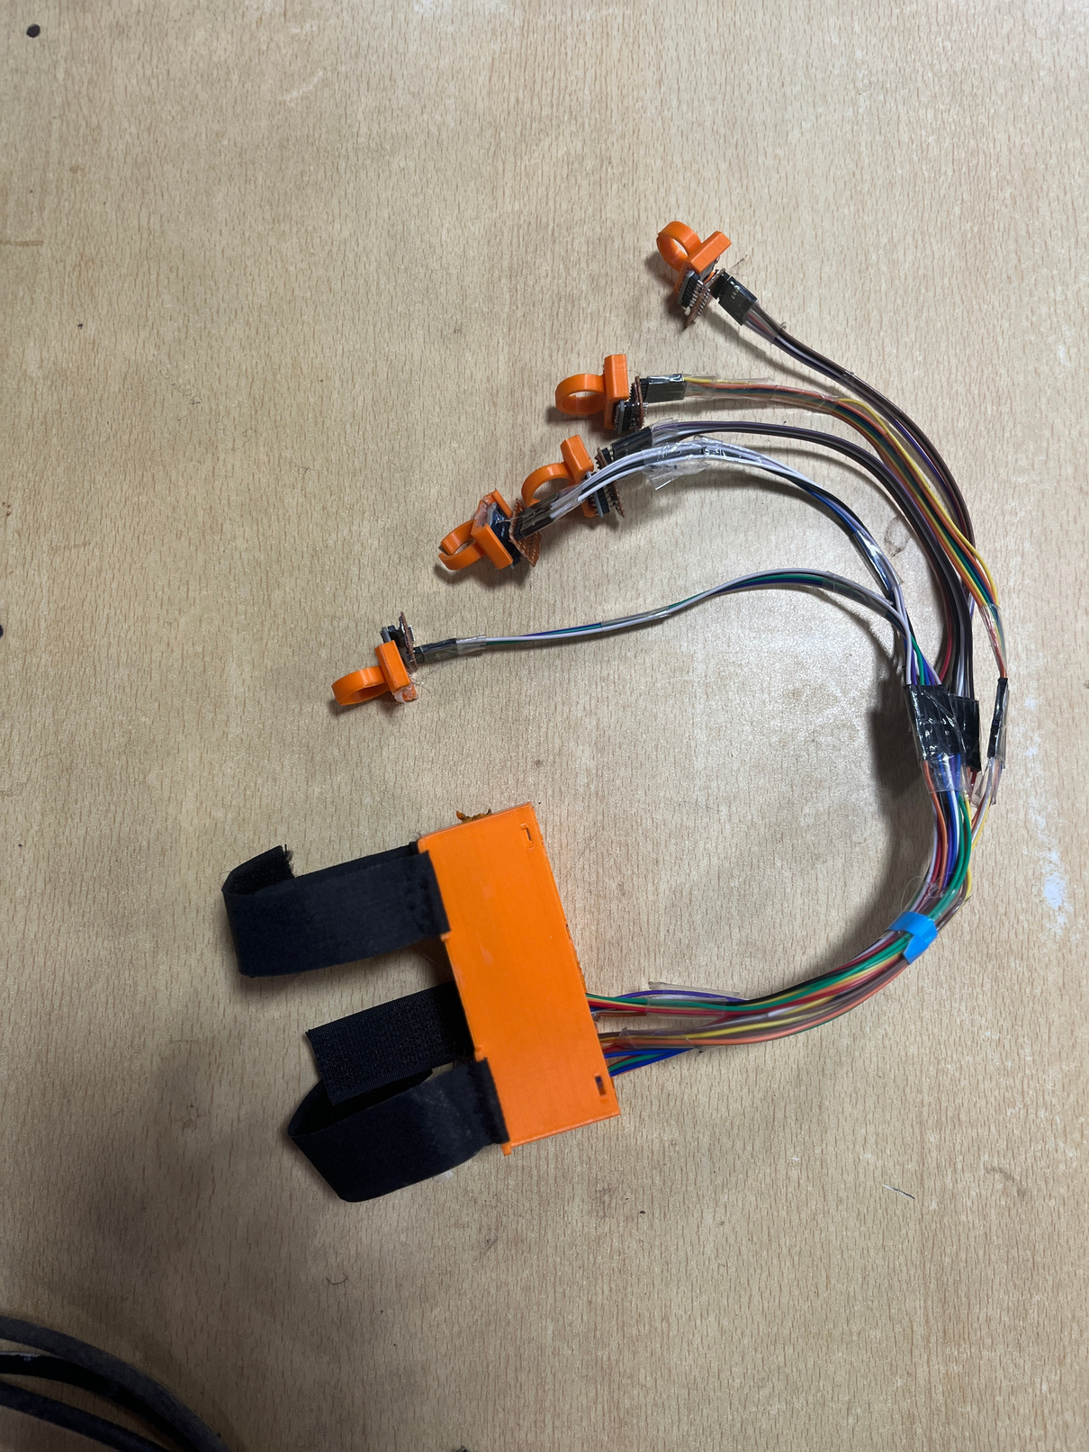

Our Solution
Voicer, a small, portable device that uses a sensor to machine learning algorithm to translate sign language into audio. This allows deaf and hard-of-hearing people to communicate with hearing people in real-time, without the need for an interpreter.

Slide 7


Our Solution
Key Features and Functionalities of the Device
Real-time audio translation of sign language gestures.
Portable and user-friendly design.
Ability to bridge communication gaps without the need for sign language interpreters.
Future Developments
Enhancements to support additional sign languages
Potential collaborations with the deaf community, researchers, and technology experts.

Slide 8
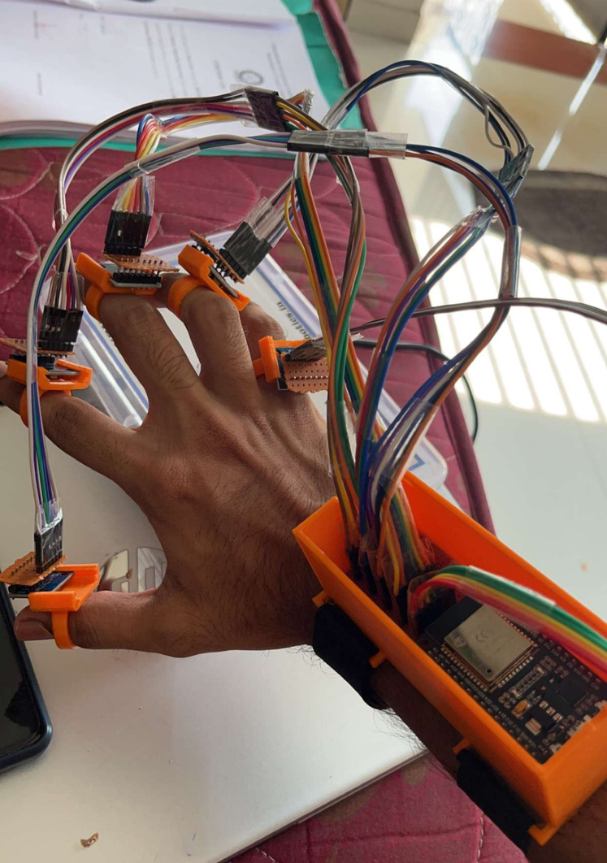
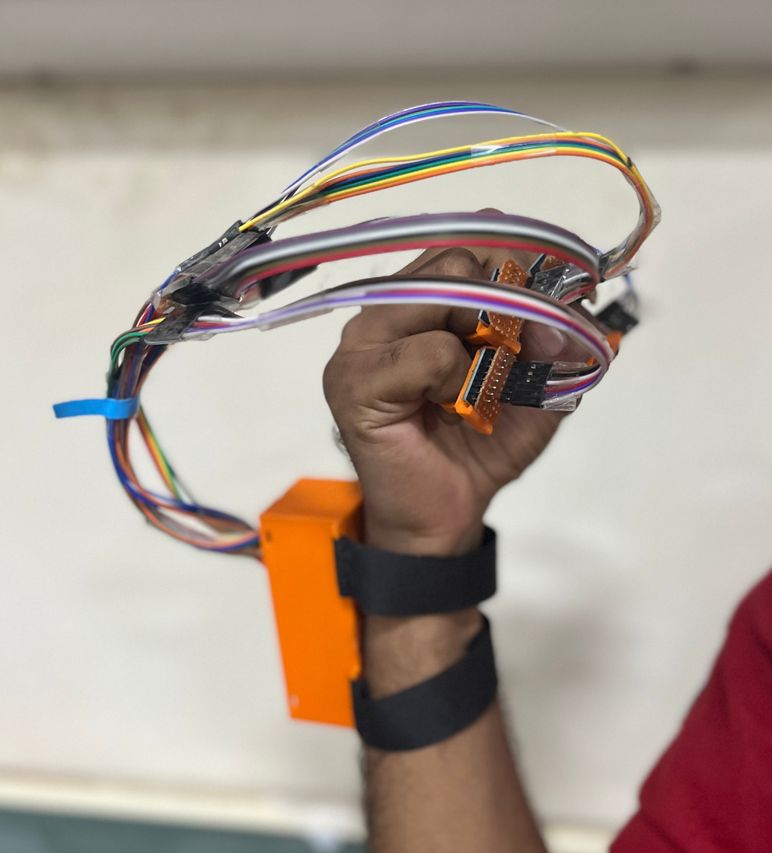
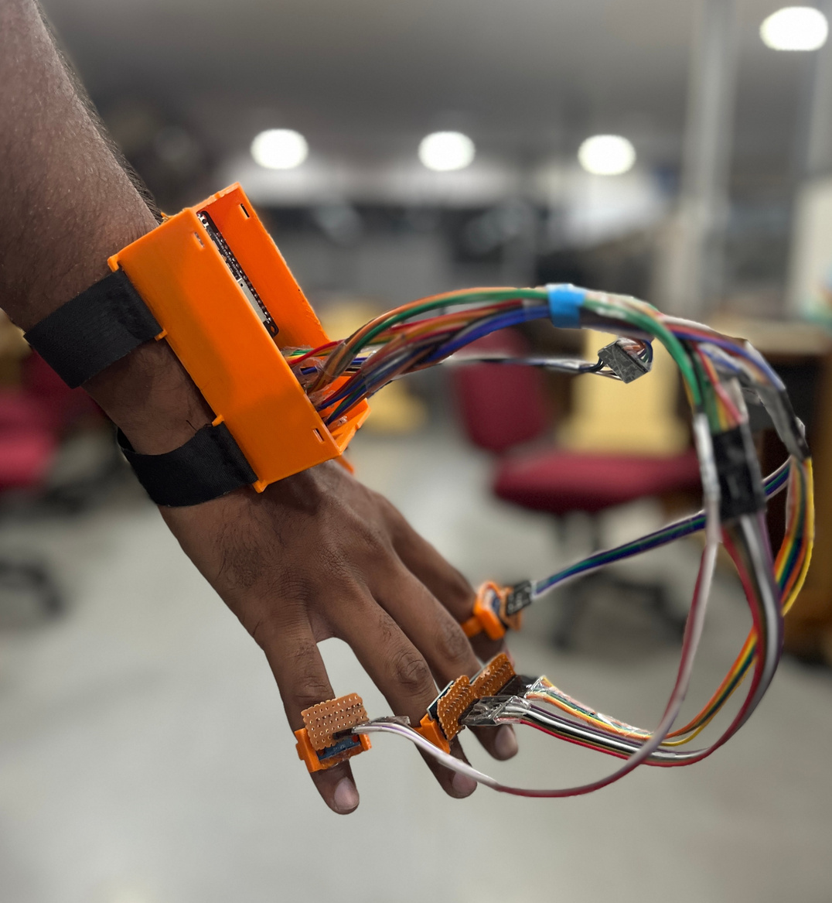
Product (MVP)

Slide 9


Size of the Market
10,000
Total Available Market (TAM):
72 Million
10 Million
Serviceable Available Market (SAM):
10 Million
72 Million
Serviceable Obtainable Market (SOM)
10,000

Slide 10
Business Model
Key Partnerships
Sign Language Experts
Educational Institutions
Medical Experts
Distribution and Sales Partners
Key Activities
Research and Development
Dataset Expansion
Manufacturing and Quality Control
Marketing and Sales
Customer Support
Value Proposition
Decrease Communication Barriers
Increased independence and confidence
Improved quality of life
Reduced rely on interpreters
Customer Segments
Individuals who use sign language
Customer relationships
Customer Support
Training and Education
Feedback
Continuous Improvement
Key Resources
Technological Infrastructure
Skilled Workforce
Partnerships and Collaborations
Distribution channels
Direct sales
Online retailers
Physical store
Partnerships
Cost Structure
Manufacturing
Marketing
Distributors
Revenue streams
Customers/Device Sales
By selling merchandise
Partnership
Logistic
Servers
Human Resources

Slide 11

Financials for MVP
Items which are needed | Estimated Cost (₹)
Controller | 2000
PCB | 2000
Sensors | 2800
Wires | 500
Audio Module | 2500
Designing | 1000
Server Charges | 1000
Maintains Cost | 900
TOTAL | 12,700 ≈ 13,000

Slide 12
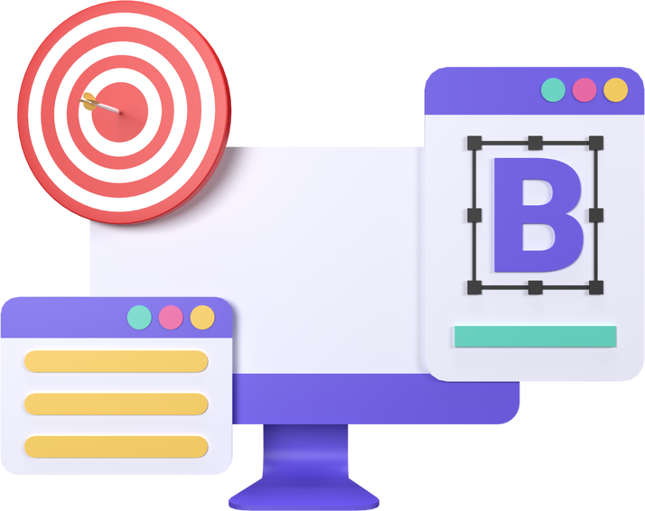

Competition in the MARKET
Limitation of Existing Solutions
Primarily focus on American Sign Language (ASL) or British sign language (BSL).
Software Dependency (constraints of the phone)
Uniqueness of Our Solution
Mainly focus on Indian Sign Language (ISL)
Audio output for better understanding.
Portability and accessibility anytime, anywhere

Slide 13
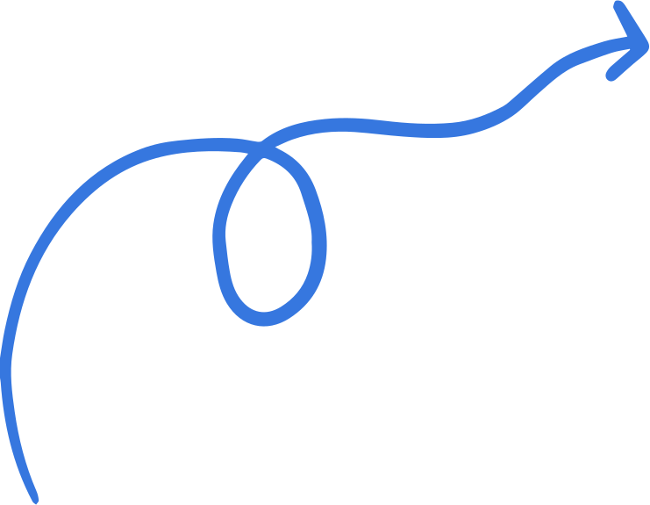

Do you have any questions?
We hope you enjoyed our pitch.

